Slide 1
Distribution Channels project
By Memphis B ,Finn T ,Roan H ,Riley P

Slide 2

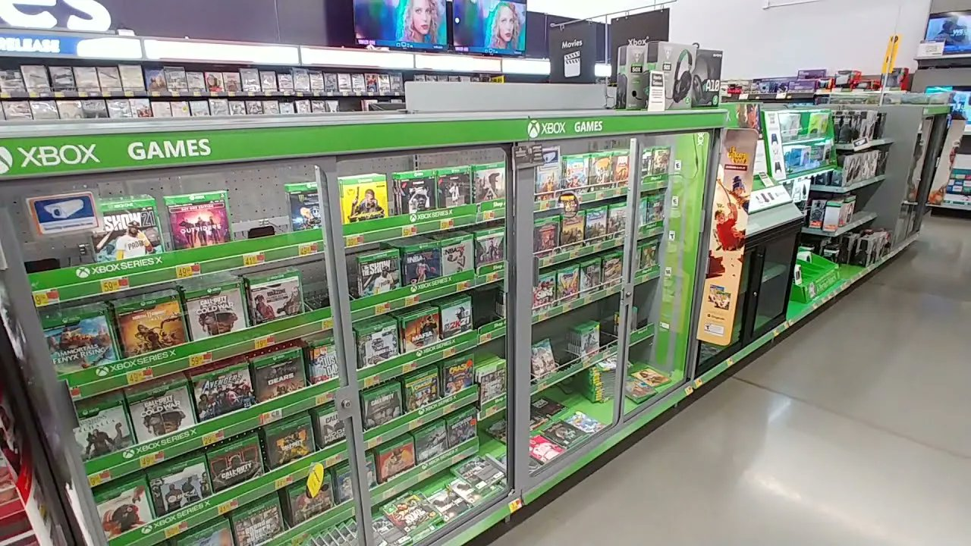
Physical media- Riley
Pros:
Once you buy it you never have to pay for it again
You can get a refund very easily if you don't like it
DVDs support the maker more than streaming services do
Isn't as dependent on internet as streaming services
Cons:
More expensive than digital media
Harder to purchase
Only available in some stores
Takes up space

Slide 3


Digital Downloads - Roan
Digital Download platforms like steam and epic games are platforms that people can purchase, download, and manage video games that you publish to those platforms.
PROS:
Cheaper than physical media
Games are easily updated
Players have instant access to games they buy
Only $100 on platforms like steam to publish a game.
Games are always saved and can’t be lost.
Games are easily refunded on some platforms like steam.
CONS:
Requires lots of hard drive storage
It needs internet access to download games
If a platform goes out of business you can lose access to your games.

Slide 4
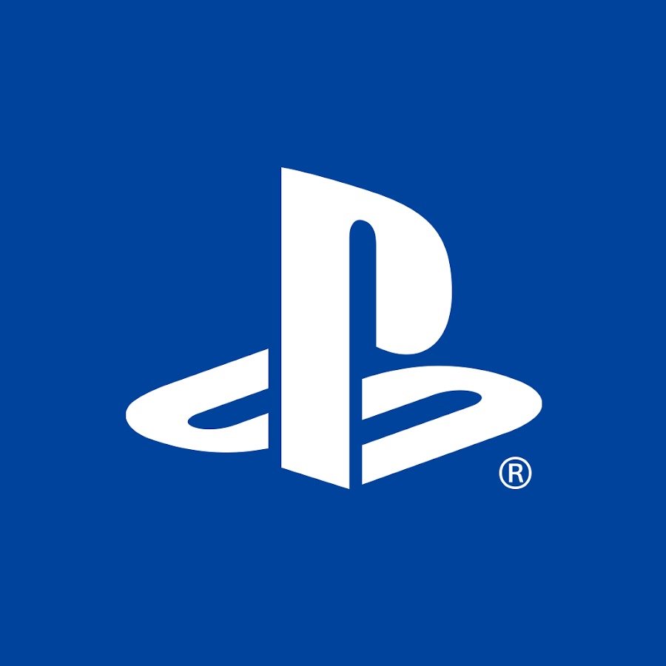





Streaming Services - Finn
PROS:
Saved to a cloud - can be accessed from anywhere
Lots of options: Amazon Luna, PlayStation now, Xbox Cloud Gaming, etc.
Saves progress across all platforms
Don’t have to buy multiple physical/digital copies of a game
CONS:
Highly dependent on internet connection
Trusting one software with all of your games
Highly dependant on latency - games more likely to run slower
Most require a subscription on top of game costs

Slide 5


Apple App Store/Microsoft Store
By Memphis Black
pros:
Quality Control: Apple reviews all apps, so games are safe and work well.
Apple Devices: Games work well across iPhones, iPads, and Macs, with features like Game Center and iCloud.
Apple Arcade: Subscription service that gives you access to lots of games for a monthly fee, with no ads or in-app purchases.
Security and Privacy: Apple is known for protecting user data and preventing harmful apps.
Mobile Game Selection: A large library of mobile games, from casual to more serious titles.
Cons:
Microsoft Account Needed: You need a Microsoft account to buy games and use services like Game Pass.
Store Interface: The Microsoft Store app can be difficult to navigate compared to other stores.
Digital-Only Purchases: No option to buy physical copies of games from the Microsoft Store.
Cloud Gaming Needs Internet: Streaming games requires a fast and stable internet connection, so it can be frustrating if your internet is slow.

Slide 6
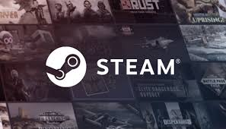
Conclusion - Roan
My group would choose to publish our game on a digital download platform first. We would probably use steam as our first platform. One of the reasons for this is cost. It costs only a one time fee of $100 to publish a game on steam which is much more affordable to us than using something like physical media. Our game would also be easily distributed and anyone could buy and download it from steam. Another benefit is we can easily update and improve our game after publishing. Steam would be better than streaming services too because you only need an internet connection to download the game but once it is downloaded you don’t need internet anymore unlike streaming services.

